Slide 1

The SCARAB
Stuart Rossiter
C00284845
October 2025
Year 4 Software Development SETU

Slide 2
Overview
What is it?
What’s the problem it aims to solve?
What does the device entail?
What does the PC program entail?

Slide 3
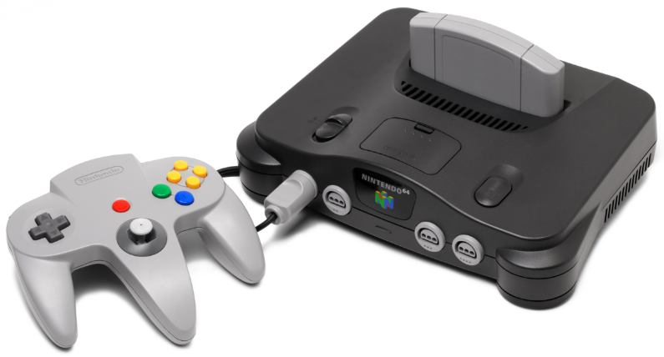
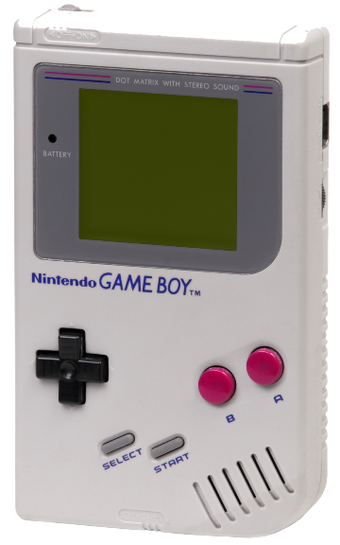
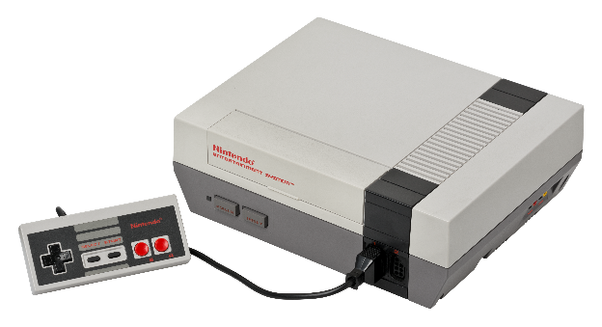
SCARAB
Figure 1
Modular Game Cartridge Health Checker and Save Manager.
Allows checking of hardware, such as cartridge pins, save retention
Interfaces with a PC program.
Stores saves as files on PC.
Figure 2
Figure 3

Slide 4
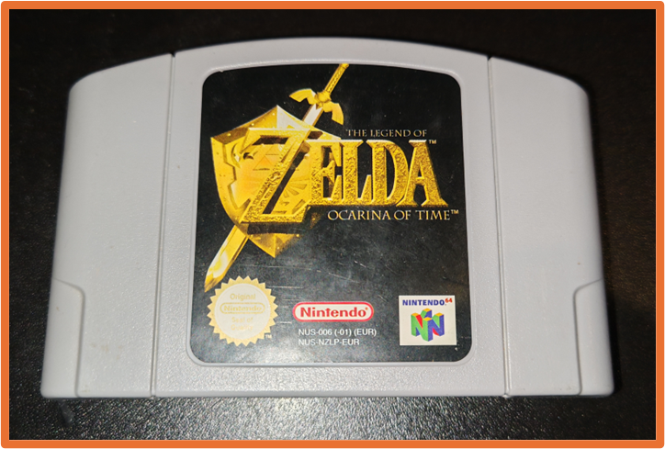
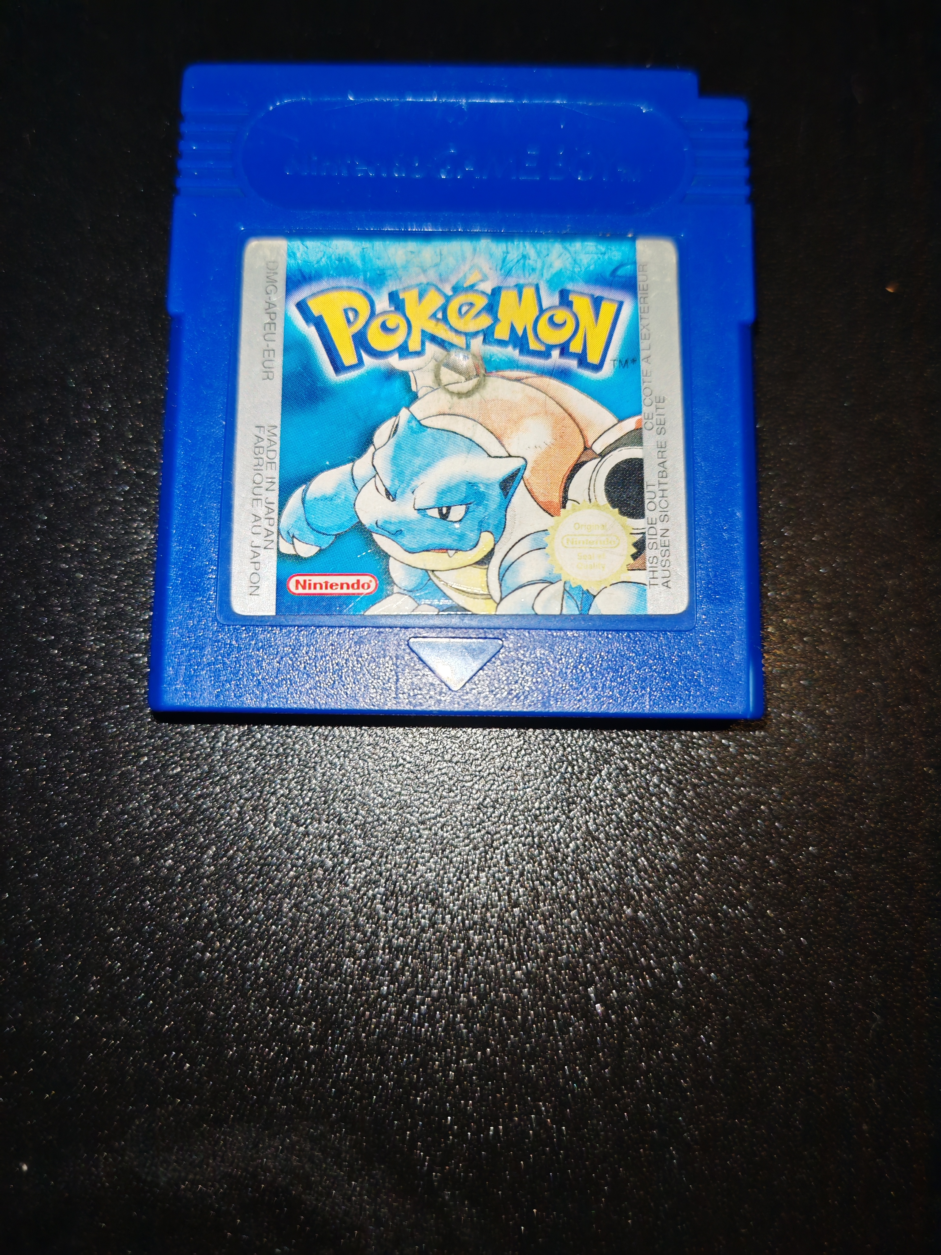
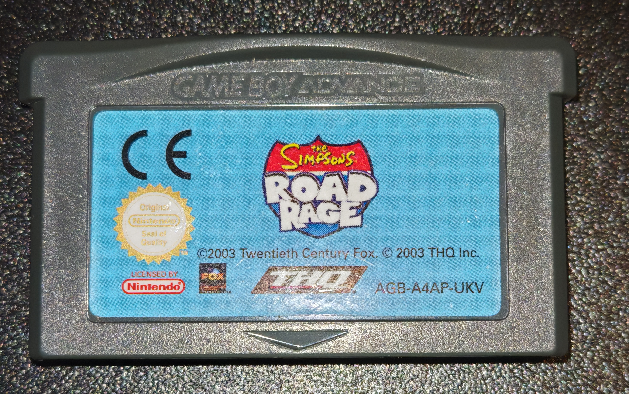
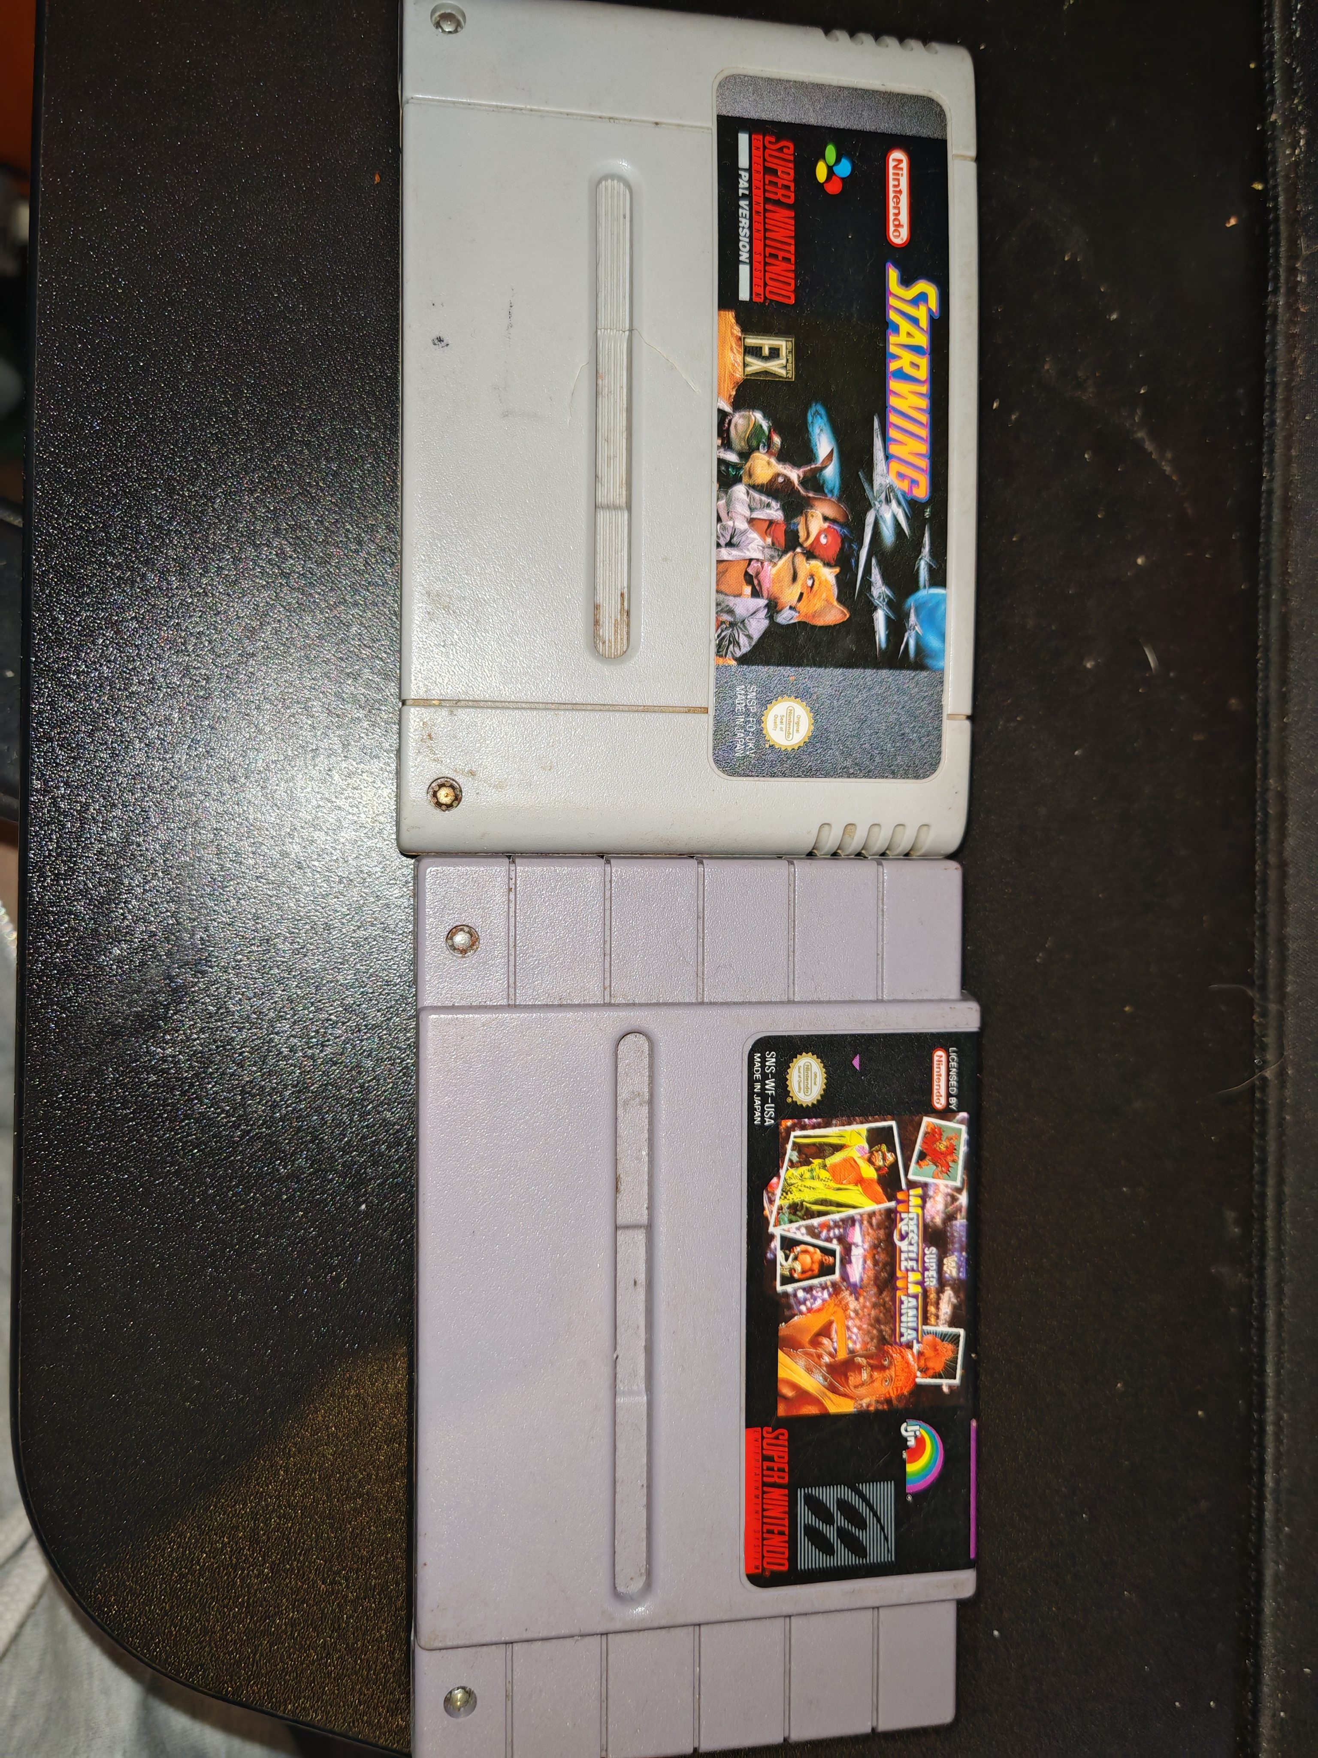
Problem
Hardware decays over time
Issues go undiscovered
Focus is primarily on software preservation
Retro cartridges need help
Too much variety of cartridges

Slide 5


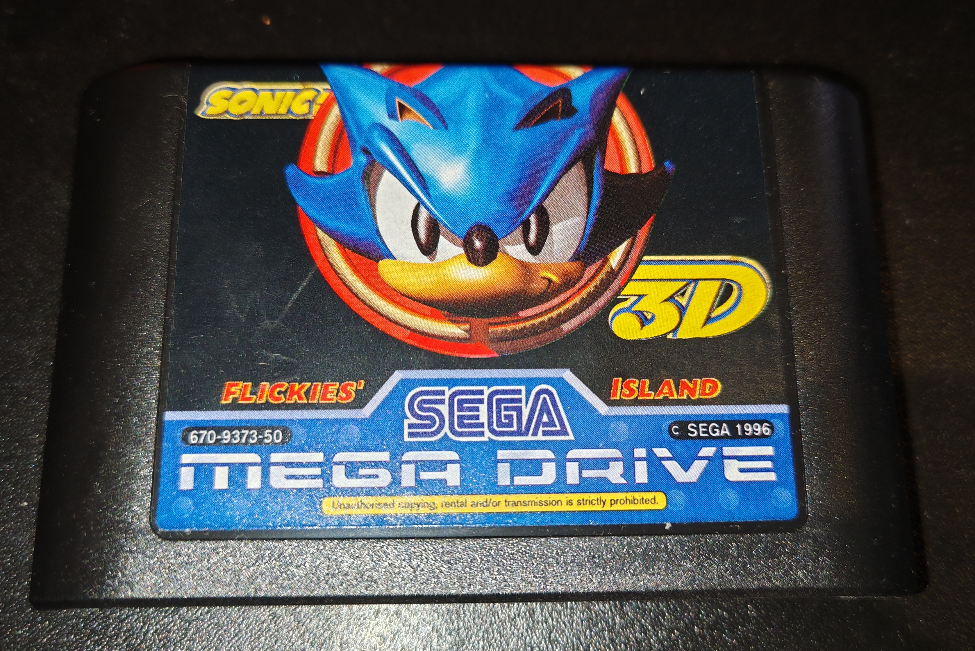
SCARAB Device
Figure 4
Modular Design
Cartridge Port Modules
Powered by Arduino Mega 2560
Dumps and Restores Save Data
Tests Pins
Validates Checksums
Tests Save Data Retention
Identifies Corruption

Slide 6


SCARAB PC Program
Interfaces with the SCARAB Device
GUI Based
Stores and Manages Save Data
Figure 5
Figure 6

Slide 7
Questions?

Slide 8
References
Figure 1: Amos, E. (2022). User:Evan-Amos/VOGM/N64 - Wikimedia Commons. [online] Wikimedia.org. Available at: https://commons.wikimedia.org/wiki/User:Evan-Amos/VOGM/N64 [Accessed 21 Oct. 2025].
Figure 2: Amos, E. (2010). File:Game-Boy-Original.png - Wikimedia Commons. [online] Wikimedia.org. Available at: https://commons.wikimedia.org/wiki/File:Game-Boy-Original.png [Accessed 21 Oct. 2025].
Figure 3: Amos, E. (n.d.). User:Evan-Amos/VOGM/NES - Wikimedia Commons. [online] commons.wikimedia.org. Available at: https://commons.wikimedia.org/wiki/User:Evan-Amos/VOGM/NES [Accessed 21 Oct. 2025].
Figure 4: Wikimedia Commons. (2013). English: Arduino Logo. [online] Available at: https://commons.wikimedia.org/wiki/File:Arduino_Logo.svg [Accessed 21 Oct. 2025].
Figure 5: Python.org. (2024). The Python Logo. [online] Available at: https://www.python.org/community/logos [Accessed 21 Oct. 2025].
Figure 6: GitHub. (2025). PySide (read-only). [online] Available at: https://github.com/pyside [Accessed 21 Oct. 2025].

